Slide 1
3-5 Discrete Uniform Distribution
Definition

Slide 4
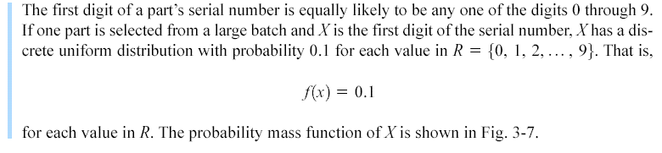
3-5 Discrete Uniform Distribution
Example 3-13

Slide 5
3-5 Discrete Uniform Distribution
Figure 3-7 Probability mass function for a discrete uniform random variable.

Slide 6
3-5 Discrete Uniform Distribution
Mean and Variance

Slide 11
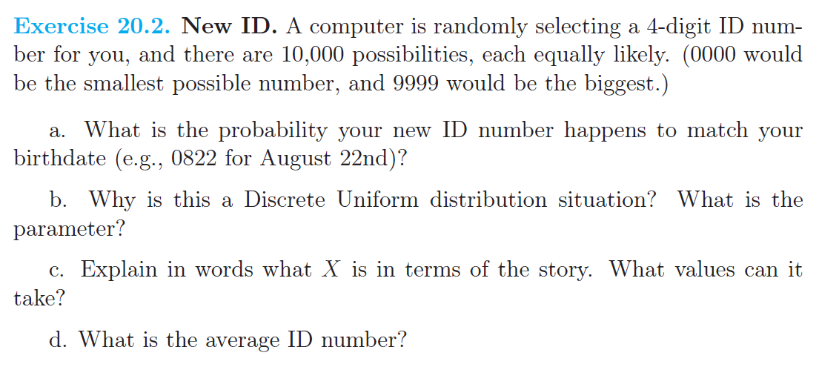
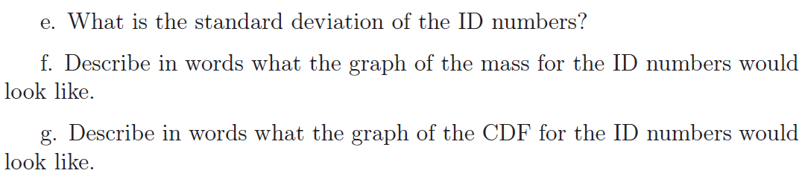

Slide 12
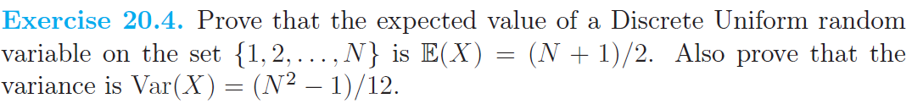

Slide 13
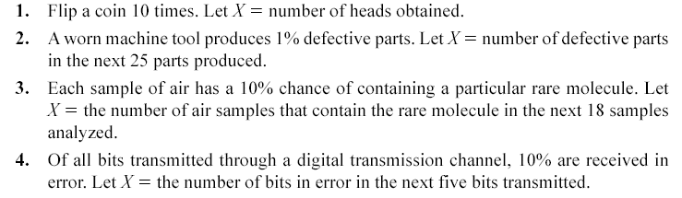
3-6 Binomial Distribution
Random experiments and random variables

Slide 14
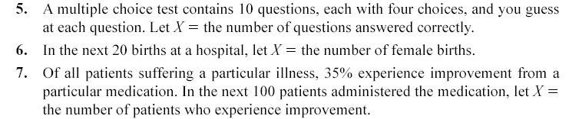
3-6 Binomial Distribution
Random experiments and random variables

Slide 22
3-6 Binomial Distribution
Definition

Slide 23
3-6 Binomial Distribution
Figure 3-8 Binomial distributions for selected values of n and p.

Slide 24
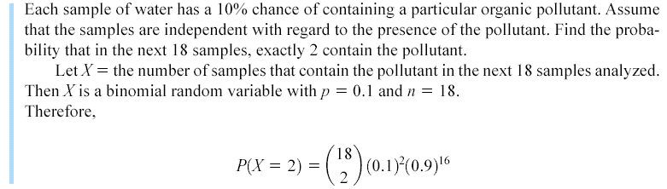
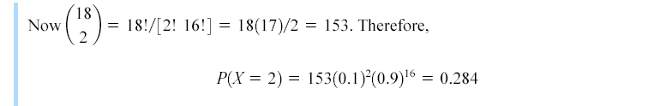
3-6 Binomial Distribution
Example 3-18

Slide 25
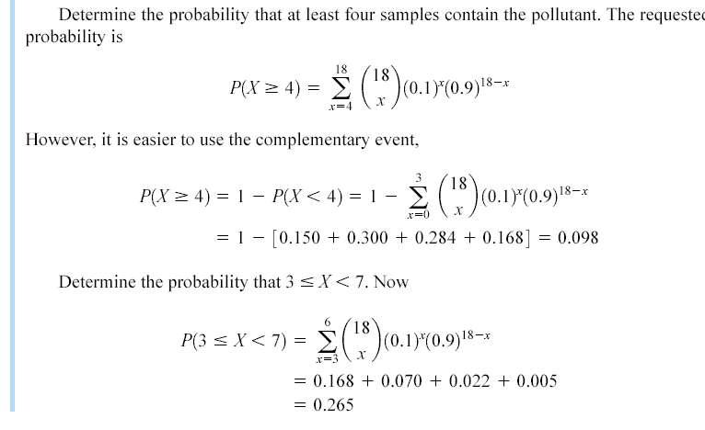
3-6 Binomial Distribution
Example 3-18

Slide 26
3-6 Binomial Distribution
Mean and Variance

Slide 30
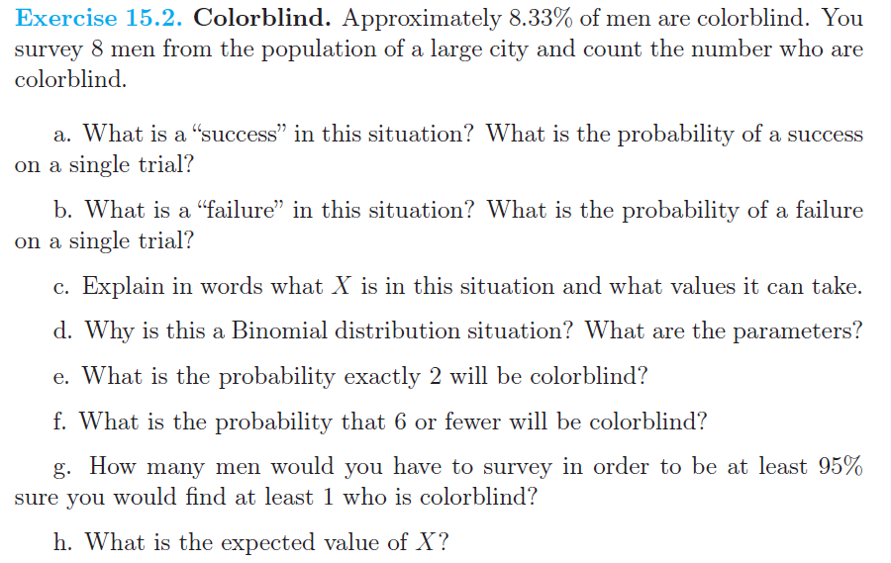
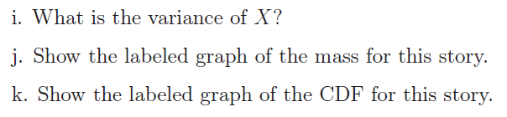

Slide 36
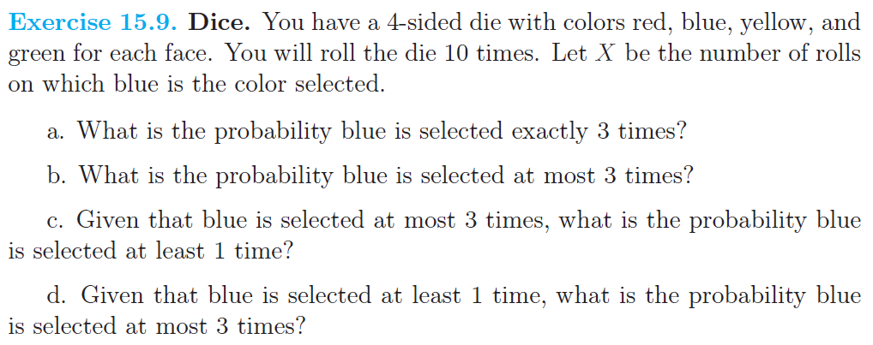

Slide 43
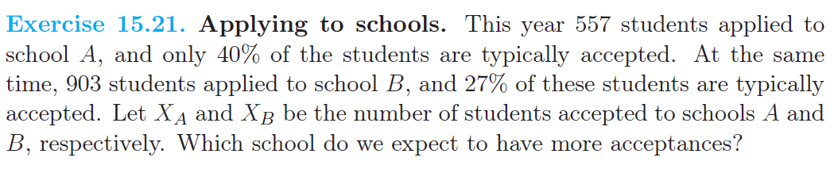

Slide 44
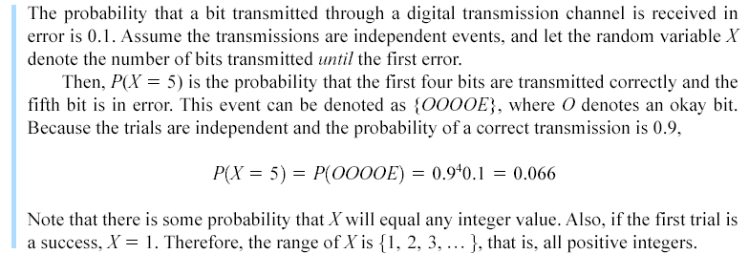
3-7 Geometric and Negative Binomial Distributions
Example 3-20

Slide 45
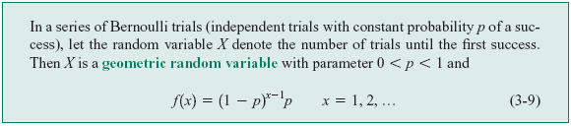
3-7 Geometric and Negative Binomial Distributions
Definition

Slide 48
3-7 Geometric and Negative Binomial Distributions
Figure 3-9. Geometric distributions for selected values of the parameter p.

Slide 49
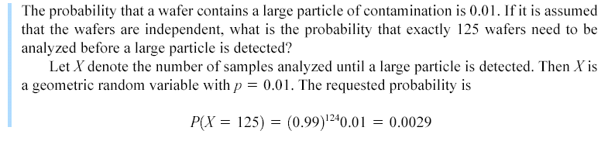
3-7 Geometric and Negative Binomial Distributions
3-7.1 Geometric Distribution
Example 3-21

Slide 50
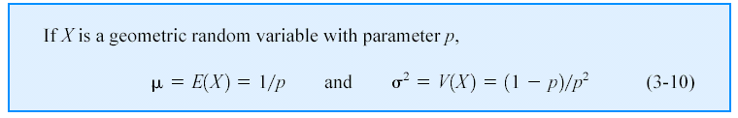
3-7 Geometric and Negative Binomial Distributions
Definition

Slide 53
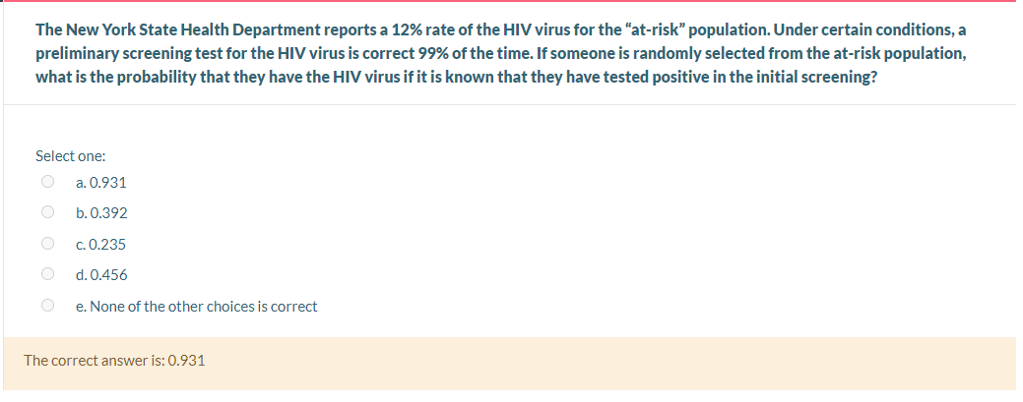

Slide 57
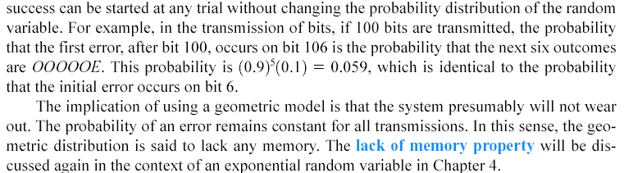
3-7 Geometric and Negative Binomial Distributions
Lack of Memory Property

Slide 58
3-7 Geometric and Negative Binomial Distributions
3-7.2 Negative Binomial Distribution

Slide 62
3-7 Geometric and Negative Binomial Distributions
Figure 3-10. Negative binomial distributions for selected values of the parameters r and p.

Slide 63
3-7 Geometric and Negative Binomial Distributions
Figure 3-11. Negative binomial random variable represented as a sum of geometric random variables.

Slide 64
3-7 Geometric and Negative Binomial Distributions
3-7.2 Negative Binomial Distribution

Slide 65
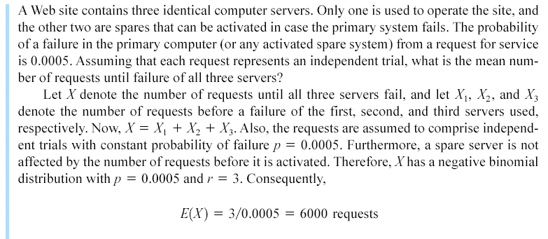
3-7 Geometric and Negative Binomial Distributions
Example 3-25

Slide 66
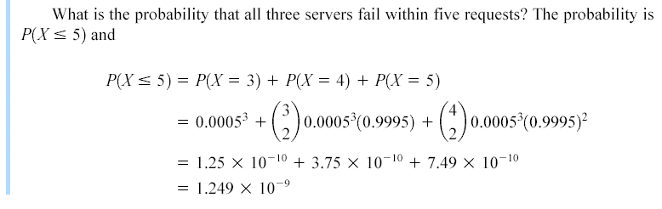
3-7 Geometric and Negative Binomial Distributions
Example 3-25

Slide 67
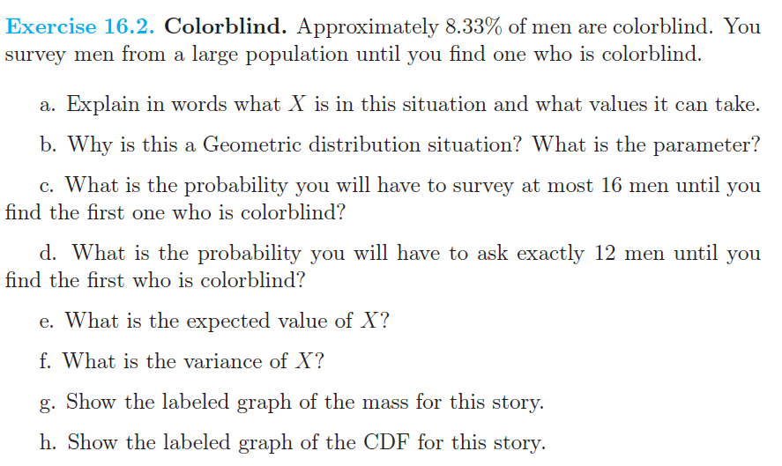

Slide 70
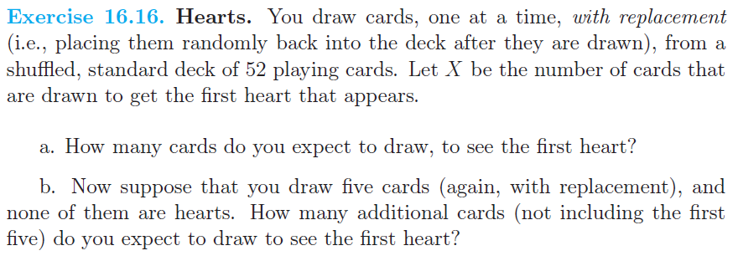

Slide 75
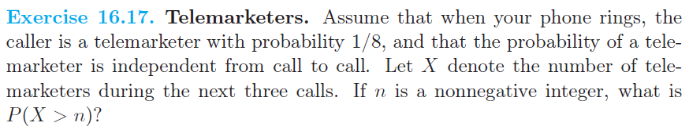

Slide 76
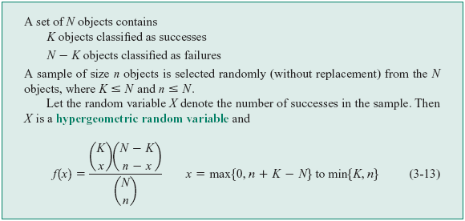
3-8 Hypergeometric Distribution
Definition

Slide 79
3-8 Hypergeometric Distribution
Figure 3-12. Hypergeometric distributions for selected values of parameters N, K, and n.

Slide 80
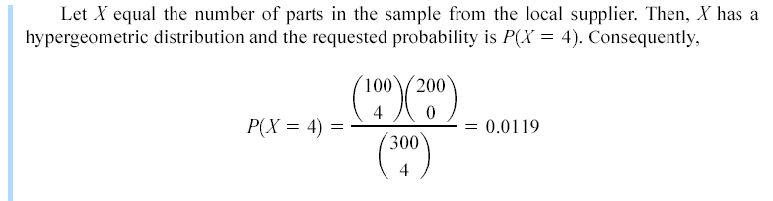
3-8 Hypergeometric Distribution
Example 3-27

Slide 81
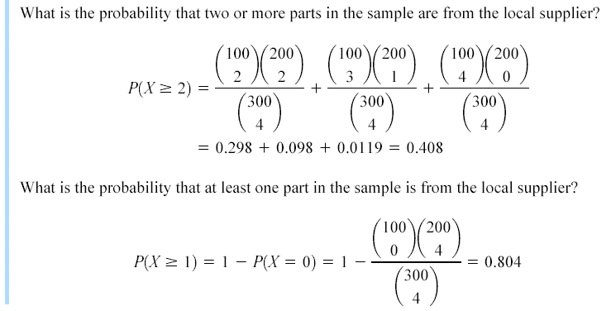
3-8 Hypergeometric Distribution
Example 3-27

Slide 82
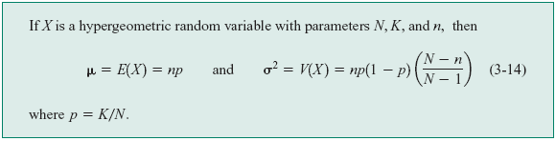
3-8 Hypergeometric Distribution
Mean and Variance

Slide 83
3-8 Hypergeometric Distribution
Finite Population Correction Factor

Slide 84
3-8 Hypergeometric Distribution
Figure 3-13. Comparison of hypergeometric and binomial distributions.

Slide 85
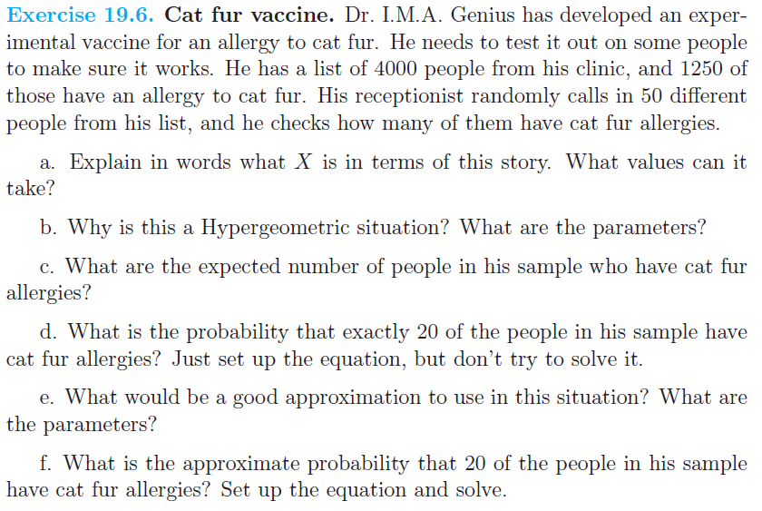

Slide 88
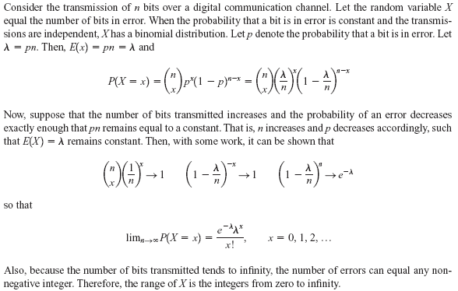
3-9 Poisson Distribution
Example 3-30

Slide 89
3-9 Poisson Distribution
Definition

Slide 92
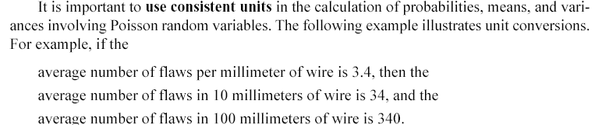
3-9 Poisson Distribution
Consistent Units

Slide 93
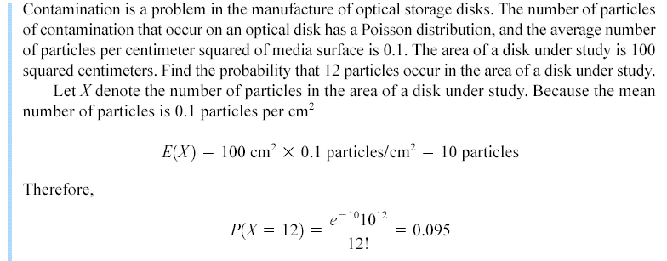
3-9 Poisson Distribution
Example 3-33

Slide 94
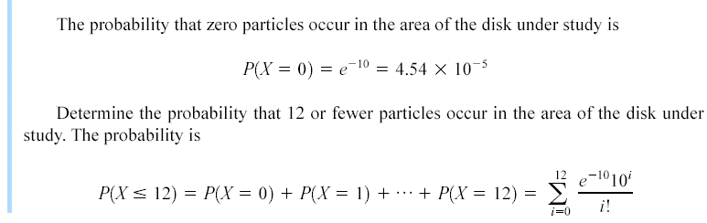
3-9 Poisson Distribution
Example 3-33

Slide 95
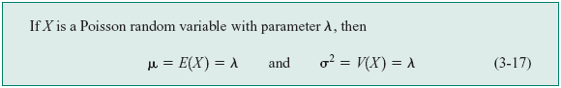
3-9 Poisson Distribution
Mean and Variance

Slide 98
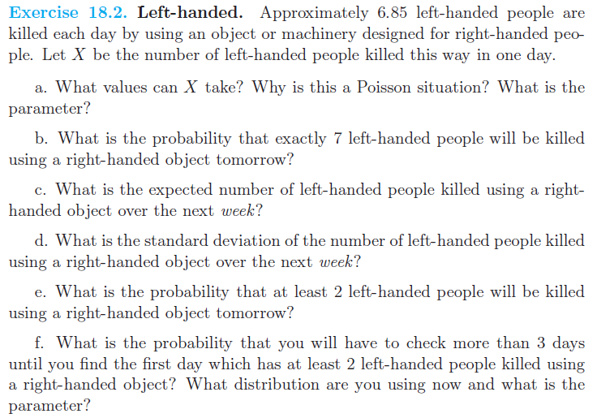

Slide 100
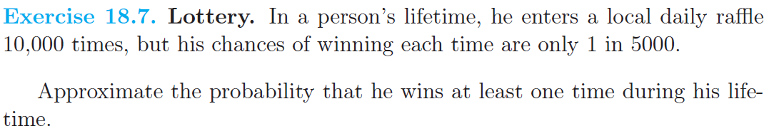

Slide 101
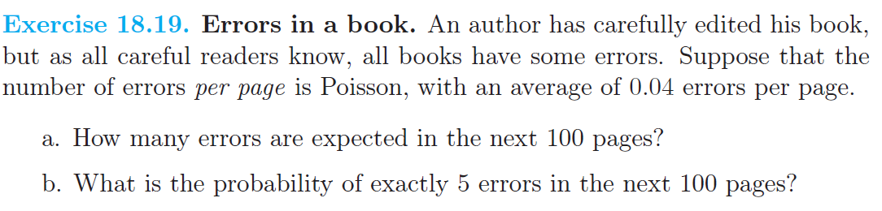

Slide 102
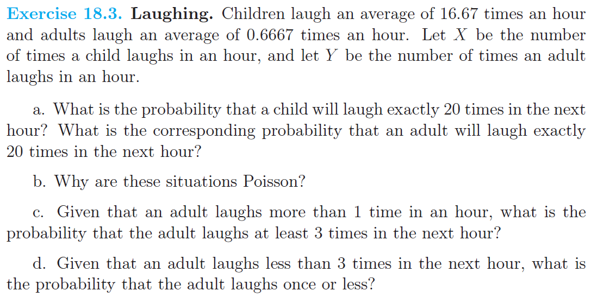

Slide 103
